Slide 1

Exploring Canada’s Labour Market
Group: Adventure Time in Data
Members: François d'Entremont, George Lee Tannous, Cindy Lu
Notes:
First and foremost we want to thank you all for being here today for our data exploration presentation

Slide 2
Introduction
Explore Canada’s labor market through the lens of data science. In this project we’ll examine the Labour Force Survey (LFS) and the characteristics that play a crucial role in predicting occupations, such as education, immigration status, sex and more
Notes:
In this project, we will use data science to explore the inner workings of the Canadian labor market. By leveraging the rich information contained in the Labour Force Survey (LFS), a monthly survey conducted by Statistics Canada, we will uncover insights and trends that can help us understand the current state of the labor market in Canada.
We will use R to clean and transform the Labour Force data, and then use exploratory data analysis to uncover patterns and trends hidden within the data. Our goal is to use predictive modeling to predict our target variable, “occupation type," which refers to a worker's occupation at their main job. This will allow us to classify and understand the data in a new way.
By the end of this project, we will have a greater understanding of the Canadian labor market and the ability to use data science to uncover valuable insights.

Slide 3
Data Preparation: Labour Force Survey (LFS)
Tidying
Trimming
Normalizing
Dataset Subsetting
Notes:
Our main steps in data preparation where
TIDYING
TRIMMING
NORMALIZING
DATASET SUBSETTING
The Labour Force Survey (LFS) is a monthly survey conducted by Statistics Canada that provides information on the current state of the Canadian labor market. The data used in this project comes from the October 2022 LFS and is released as a public use microdata file, which means that it contains individual-level data for a wide range of variables. The raw dataset itself consisted of 110,059 records and 60 variables. During our data prep, we decided on taking focus on a subset of 12 variables with valid values as opposed to the original 60.
- Throughout this came the actualization of the data.
The next slide highlights the 12 variables chosen and their respective meaning

Slide 4
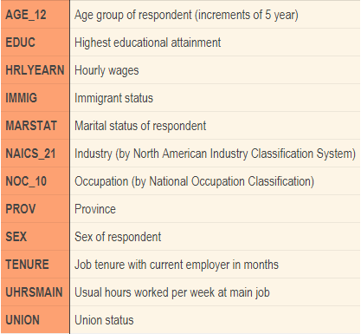
Data Preparation: Variables
Variables
Meanings
A Summary of all 12 variables, explaining their meanings
Numeric Variables:
UHRSMAIN
TENURE
HRLYEARN
Notes:
This consisted of converting taking variables such as `hourly wages` that were in the form of cents per hour and converting them to dollars per hour.
A similar approach was also taken when working with the `usual hours worked per week’ variable, where values were recalculated from ‘implied decimal’ to actual hours.
The variable data types are stored as numeric or character in the original dataset. Only the `hours worked per week`, `TENURE` and `hourly wages` are numerical variables, and the remaining ones need to be converted to categorical data types. For ease of interpretation and reference of the data, the variable levels are renamed.

Slide 5
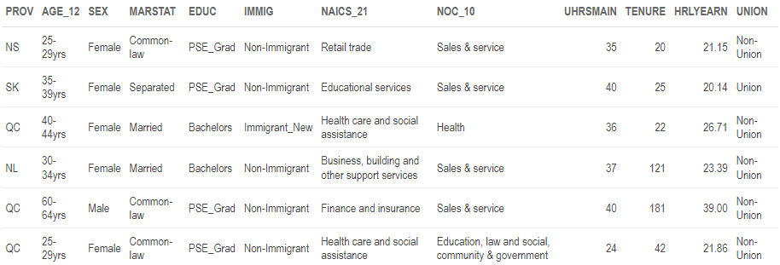
Firsts 6 rows of Labour Force Survey Data
Notes:
Here we have a look into the first 6 rows of the Labour Force Survey Data. Showing our 12 variables used throughout analysis

Slide 6

Exploratory Data Analysis
Notes:
Now it's time for Exploratory Data Analysis.
Among the 12 variables within the dataset, we are interested in predicting occupation type based on the other variables. So in the following steps, we will explore relationships between a person's occupation type, which is our proposed target variable and other variables in order to determine if the target variable is appropriate, and also identify variables that may be significant in the predictive modelling.

Slide 7
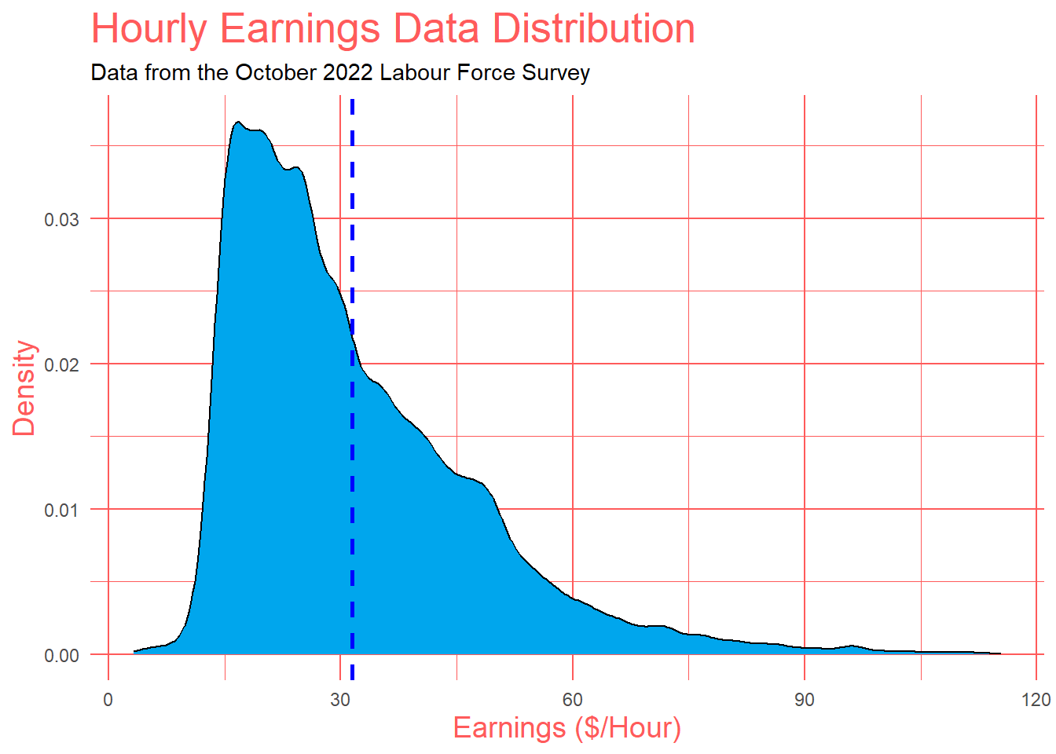
Exploratory Data Analysis
Numerical Variables:
Hourly Earnings ($/Hour)
Density plot
Right Skewed
Peak in the 15-25 range
Mean (blue dashed line)
Outliers
Remove outliers
Notes:
Starting with our Numerical variables. Density plots are a good representation of the distribution of a numeric variable. This graph shows a right-skewed distribution (also known as positively skewed), meaning most of the values fall to the right of the peak. The peak tells you where the values are most concentrated. We see that there is a high concentration of values in the 15-25 range. To the right of the peak, we see the mean at 32. Since there are people who make an absurd amount of money, we have outliers in our dataset, with some people making over 100$ per hour. These outliers aren’t representative of the bulk of our dataset so we will remove them.

Slide 8
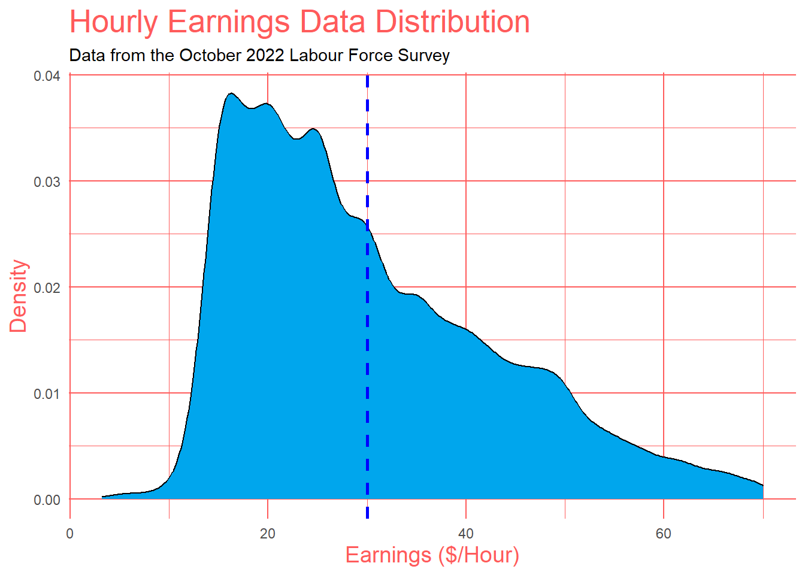
Exploratory Data Analysis
Numerical Variables:
Hourly Earnings ($/Hour) - after removing outliers
1.5 rule for outliers:
IQR = Q3 – Q1
Lower Bound: Q1 – 1.5*IQR = 0
Upper Bound: Q3 + 1.5*IQR = 70
Mean
Data normalization
Notes:
This graph shows the hourly earnings for this distribution with the outliers removed. We used the commonly used 1.5 rule for outliers in order to remove the outliers. The interquartile range describes the middle 50% of values. We removed the values lower than the lower bound, which is Q1 – 1.5 times IQR, and greater than the upper bound, which is Q3 + 1.5*IQR. In this case, the lower bound is 0 and the upper bound is 70. We notice that the mean, the blue dashed line, shifted a little bit to the left. This change of removing the outliers normalizes the data and gives us a better representation of our database.

Slide 9
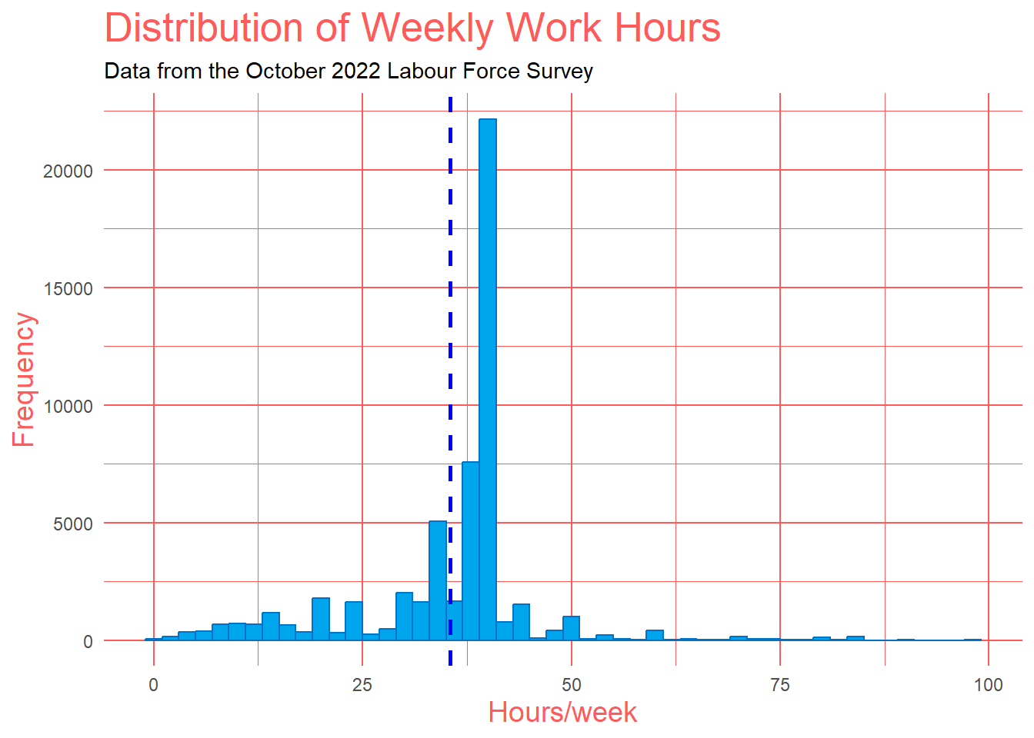
Exploratory Data Analysis
Numerical Variables:
Usual Hours Worked At Main Job (per week)
Histogram
Bin width of 2
Mean
Peak
Outliers?
Notes:
This is a histogram of the "usual amount of hours a person has worked at their main job per week". Histograms display the data by grouping data into "bins" of equal width and each bin is plotted as a bar whose height corresponds to how many data points are in that bin. Our bin width is 2 so that we can better see where exactly where the data lies. The mean of approximately 35 is to the left of the peak meaning the distribution is slightly left-skewed. This histogram shows that the majority of weekly hours worked fall between 38-40 hours per week, with a peak at around 40 hours. The plot indicates that there are relatively few observations with weekly hours above 40 per week, and a minimal number of observations with hours worked below 30. We decided not to cut the outliers for this one because it’s close to being normally distributed and not as skewed.

Slide 10
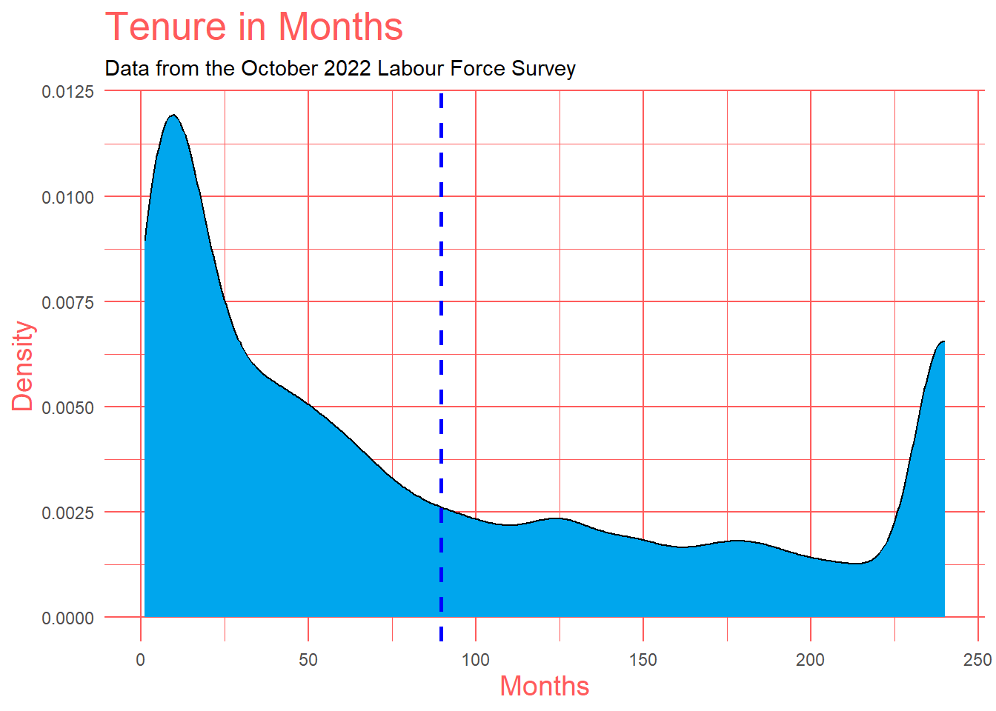
Exploratory Data Analysis
Numerical Variables:
Tenure (in months)
Density plot
Bimodal (two peaks)
Mean (blue dashed line)
Data Cap at 240 months (20 years)
Notes:
This density plot shows the distribution of "tenure for individuals employed by a company or organization". The majority of individuals have been employed for between 0 and 5 years (or 60 months). The plot then shows a decline in the density of individuals with longer tenure. This data is capped at 240 months (or 20 years), which is why there is a second peak at 240. So this information can be useful for understanding the overall tenure of employees within the occupation, which is our proposed target variable.

Slide 11
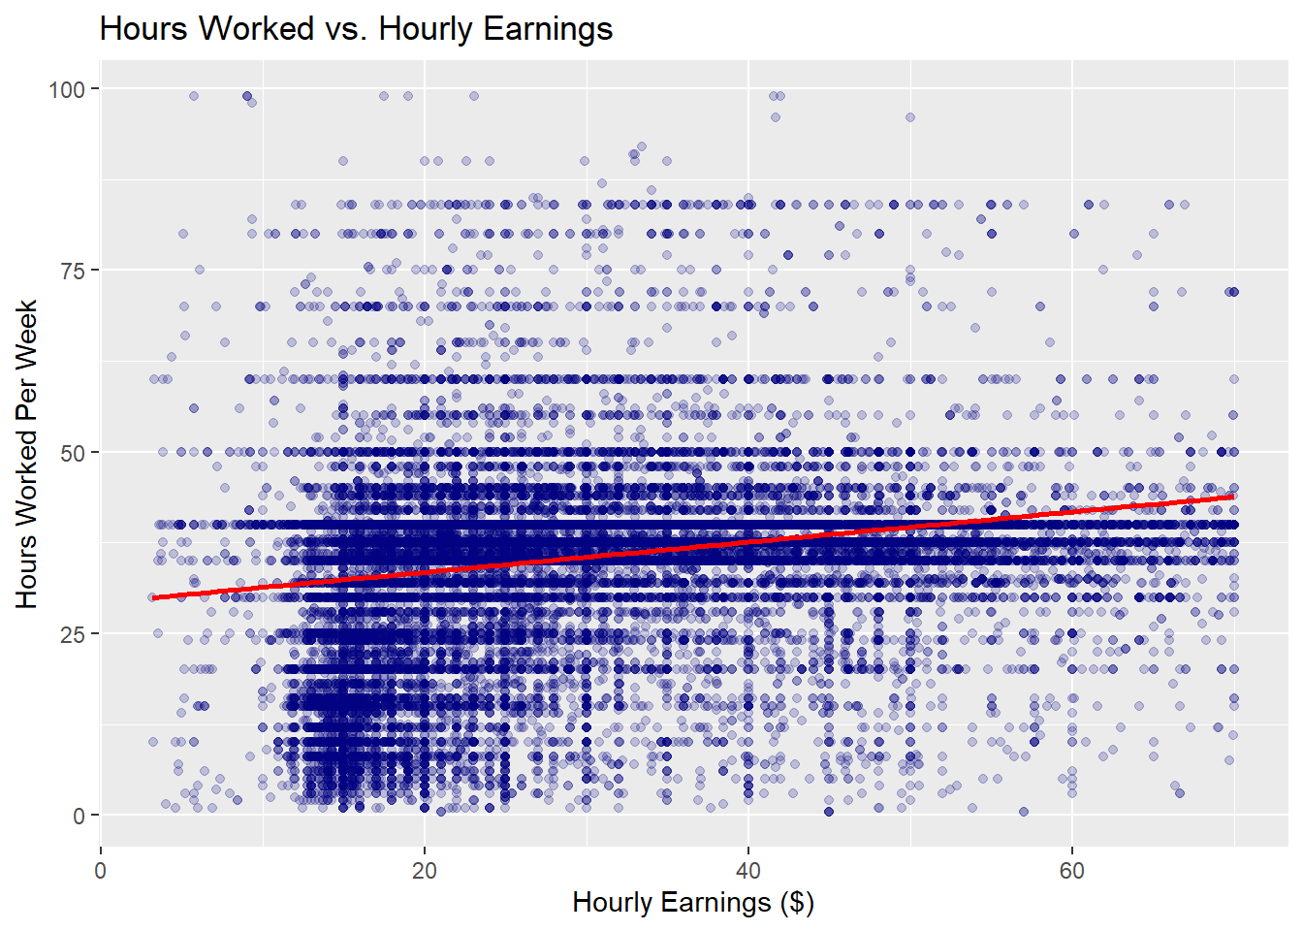
Exploratory Data Analysis
Numerical Variables (Covariation):
Hourly Earnings ($) and Usual Hours Worked At Main Job (per week)
Scatterplot
Linear Regression Line
What can we conclude?
Notes:
This is a graph comparing Hourly Earnings ($) to Hours Worked per Week. Scatterplots are a great way of seeing relationships between two numerical variables. This scatterplot shows the hourly earnings (in dollars) on the x-axis and the hours worked per week on the y-axis. The Linear Regression Line in red almost has a slope of almost 0 meaning there is minimal correlation between the two variables. We can conclude from this graph that the hourly earnings have minimal effect on the number of hours worked per week. But on their own they could both be good as predictors in our model as they can predict independently.

Slide 12

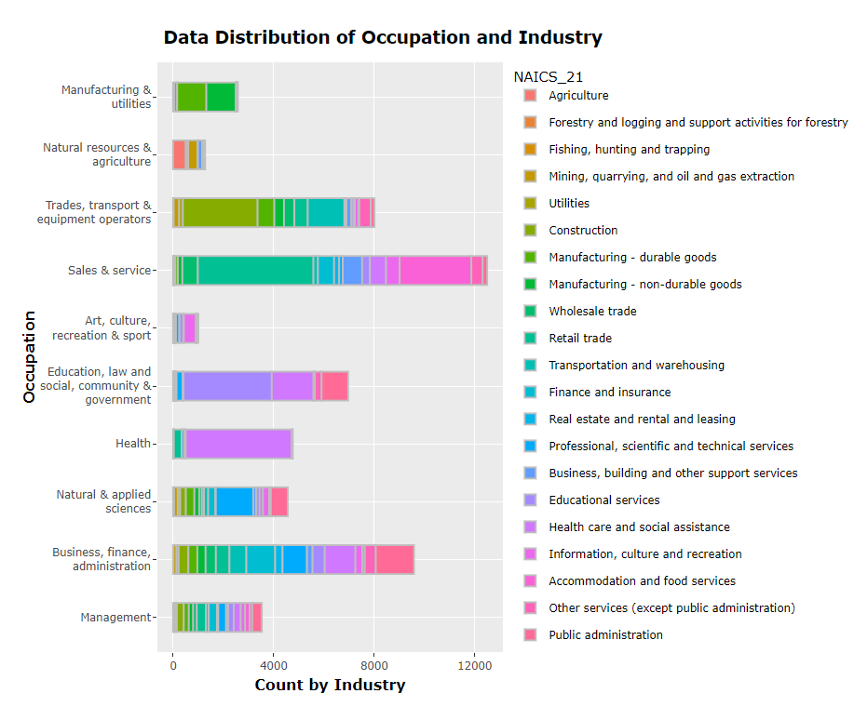
Exploratory Data Analysis
Categorical Variables and Covariation:
Occupation Type Counts Divided By Industry Type
Bar chart
Counts
Patterns
Notes:
Now for our categorical variables and covariation. Bars charts are a great way to visualize categorical data. This bar chart is showing counts for all the occupations divided by industry type, which we see in different colours. As shown in this bar chart, we can see that the survey data is not well distributed across occupation types, with more than 10 times the survey subjects working in the "sales and service" occupation in comparison to the occupation category of "art, culture, recreation and sport".
There seem to be some patterns between occupation type and industry type. For example: 4726 people with health occupations out of 4765 work in the "health care and social assistance" industry, and most people working in the retail trade industry have sales and service occupations.

Slide 13
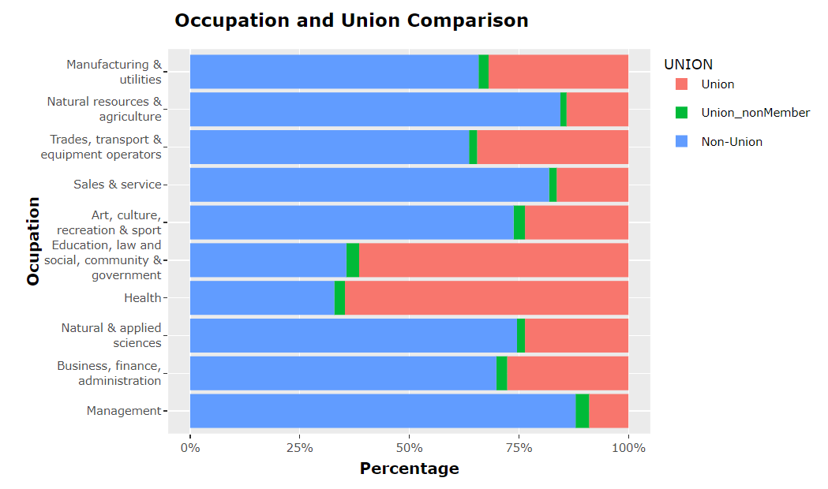
Exploratory Data Analysis
Categorical Variables and Covariation:
Percentage of Union Members in Each Occupation
Bar chart
Percentage
Patterns
Notes:
This barchart instead of showing counts, the bars are stretched and it's showing the percentage of union members in each occupation. We can see that there is a higher percentage of union members in “Health occupations” and “Occupations in education, law and social, community and government services”. This could be good for our model because it adds separability.

Slide 14
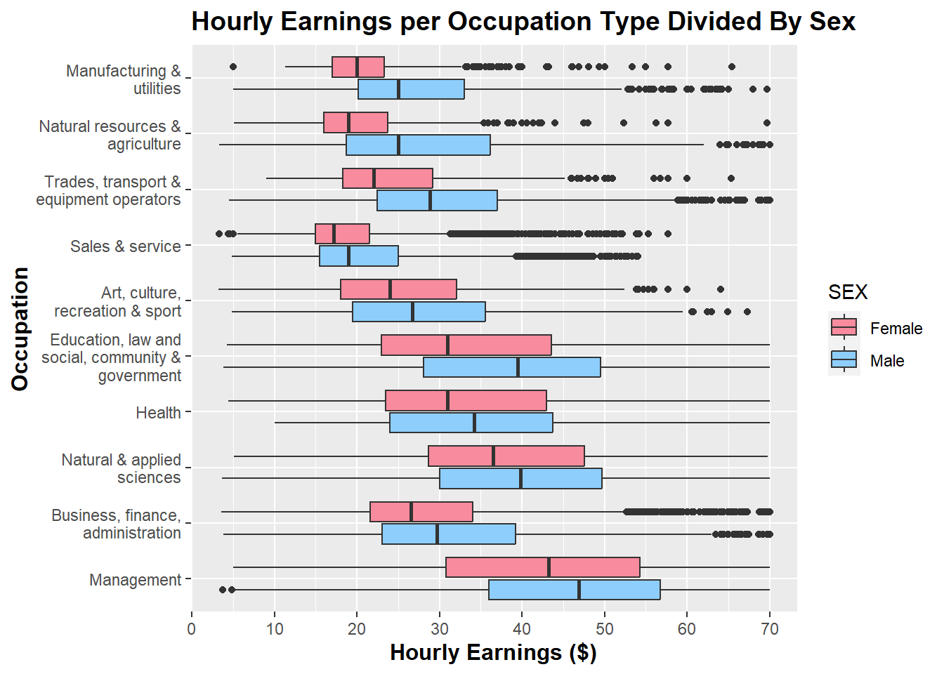
Exploratory Data Analysis
Categorical Variables and Covariation:
Hourly Earnings ($) for Each Industry Divided by Sex
Box plot
Largest Earnings
Separability
Notes:
Box plots are useful as they provide a visual summary of the data enabling us to quickly identify mean values, the dispersion of the data set, and signs of skewness. This boxplot shows the Hourly Earnings for each industry, divided by male and female. We can see that “management occupations” earn the most money, on average, followed by “natural and applied sciences and related occupations” and “health occupations”. This is good for our model in terms of separability. We also see that men earn, on average, more money per hour than women, adding more separability.

Slide 15
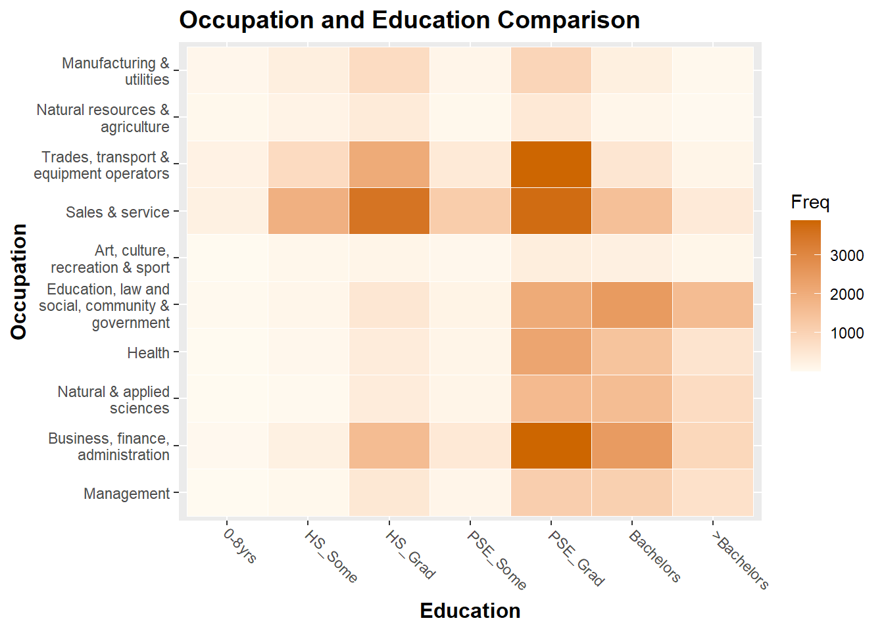
Exploratory Data Analysis
Categorical Variables and Covariation:
Occupation Type vs. Education
Heatmap
Frequency
Notes:
This is a heatmap of Occupation Type and Education. We can see that our dataset contains a high frequency of post-secondary graduates and a high frequency of people working in sales and service. This is useful information because now we now know which categories our data falls into.
Note that since there is a high variation of records across different occupations, the ‘heated’ areas in the heatmap are biased towards those with a higher number of records. For example, the number of records with an occupation in "art, culture, recreation and sport" is much lower than the other occupations, which leads to low frequencies in the heatmap.

Slide 16
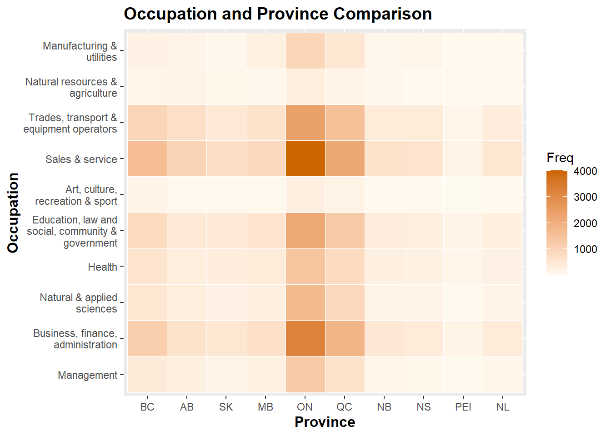
Exploratory Data Analysis
Categorical Variables and Covariation:
Occupation Type vs. Province
Heatmap
Frequency
Notes:
This heatmap of Occupation Type and Province shows there is a higher frequency of records in Quebec and Ontario. However, there is no prominent distinction in the frequency of occupations among different provinces. The frequency variation is mainly due to the uneven distribution of records. We could consider cutting this variable from our dataset.

Slide 17

Predictive Modelling

Slide 18
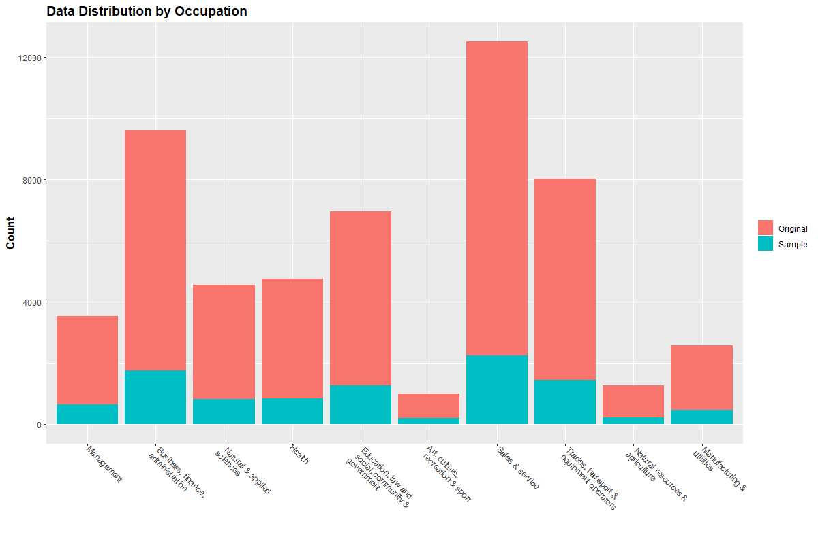
Resampling
Method 1: random samples
Method 2: stratify samples
Model Preparation
Notes:
Original survey records are not well distributed across occupation types. In addition, processing over 50,000 records will take significant compute time. For the purpose of this demonstration, we will reduce the training records to 10,000, by resampling the dataset in 2 ways.
Method 1 – randomly select 10,000 rows from the dataset, with the goal to preserve the original data distribution. (show graph)
Method 2 – with 10 levels in the target variable, sample 1000 records from each level and combine them to make up the training dataset. This ensures an equal amount of training data for each occupation type.

Slide 19
Resampling
Method 1: random samples
Method 2: stratify samples
Data Partition
Model Preparation
Training: 80%
Validation: 20%
Algorithms
Target Variable
Predictor
Algorithm Parameters
Notes:
Data partition: extract validation records that can be used to measure the accuracy of the predictive models. Retained 20% of the sample dataset in each scenario.
Final step, set the target variable (occupation type), determine predictors (all except for province), and set algorithm parameters, in which we are using 10-fold cross validation and Accuracy as the metric.

Slide 20
AGE_12
SEX
MARSTAT
EDUC
IMMIG
NAIC_21
UHRSMAIN
TENURE
HRLYEARN
UNION
Occupation
(NOC_10)
Notes:
1 target variable, 3 numerical predictors, 7 categorical predictors

Slide 21
Machine Learning Algorithms
Linear Discriminant Analysis
Classification & Regression Tree
Random Forest
K-Nearest Neighbors Classifier
Support Vector Machine
Notes:
Ran 5 algorithms, all successful. Note SVM and RF took longer time.
RF also did not produce a valid confusion matrix, which we will touch on later.

Slide 22
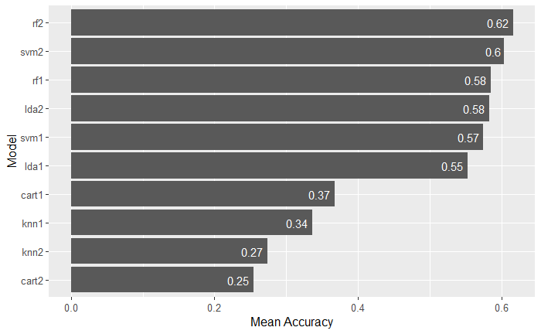
Model Accuracy
Notes:
the Random Forest with re-sample method 2 produced the most accurate predictive model, followed by the Support Vector Machine.
There is no consistent result regarding the data sample methods, i.e. training equal number of records for each `NOC_10` levels did not consistently lead to more accurate model output, or vice versa. The model performances are further evaluated through the confusion matrices in the next section.

Slide 23
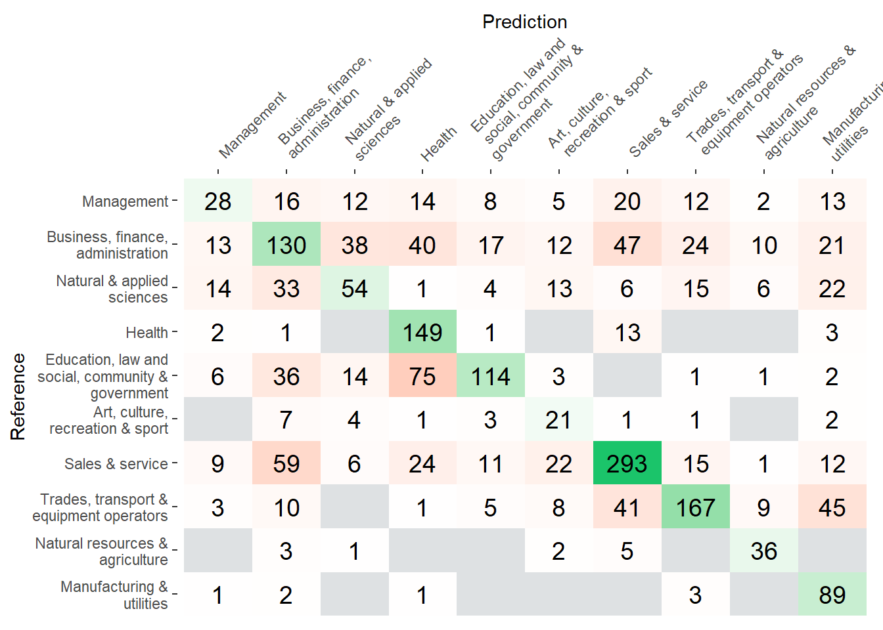
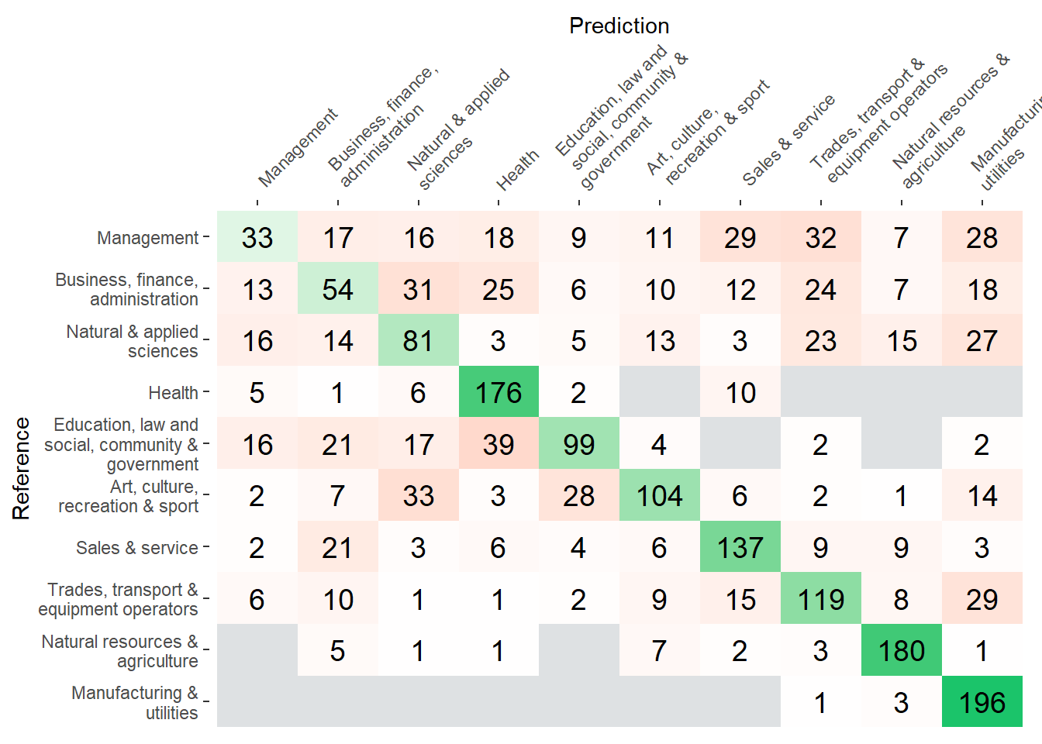
Model Performance Comparing Resample Methods
LDA – Resample Method 1
LDA – Resample Method 2
Notes:
How to read the CM (green, orange, shades, grey)
LDA Method 1 – takes volume and distribution of training data into consideration. More values in the Sales & service occupation, least in art. (see barchart)

Slide 24
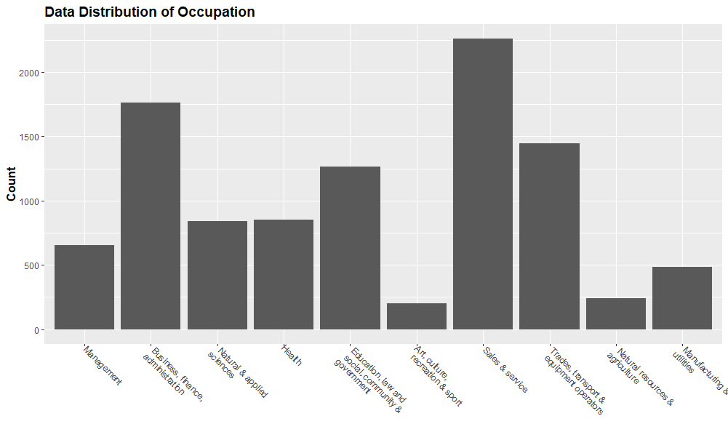
Model Performance Comparing Resample Methods
LDA – Resample Method 1
Notes:
LDA Method 1 – takes volume and distribution of training data into consideration. More values in the Sales & service occupation, least in art.

Slide 25
Model Performance Comparing Resample Methods
LDA – Resample Method 1
LDA – Resample Method 2
Notes:
LDA Method 2 – easier to compare model performance and justify its strength and weakness. Poor at predicting management, great at manufacturing & utilities, good at Health, Natural resource.

Slide 26
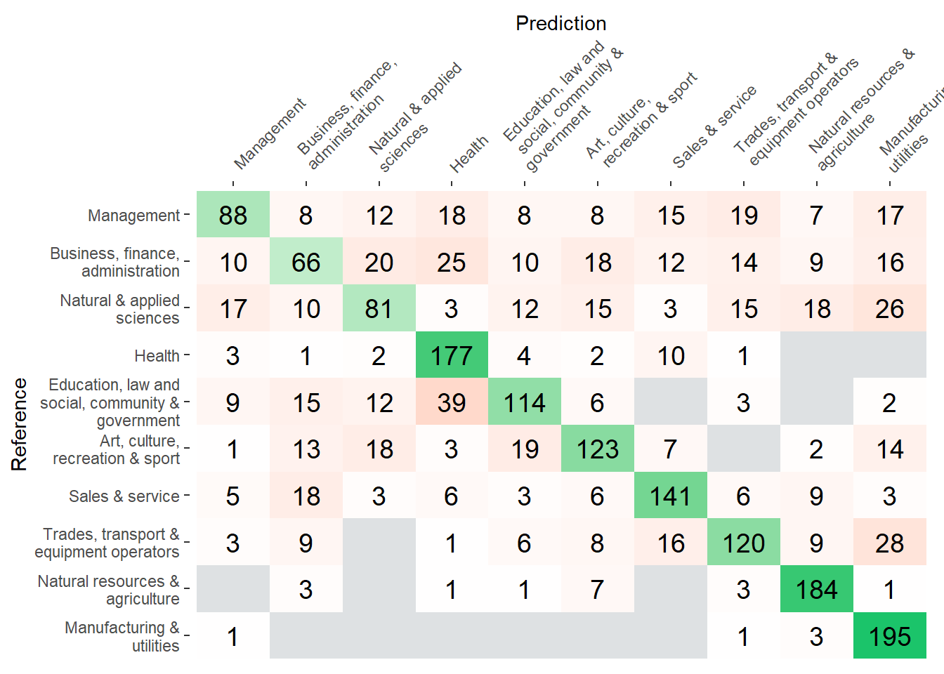
Model Performance Comparing Classification Algorithms
SVM – Resample Method 2
LDA – Resample Method 2
Notes:
Good at predicting manufacuting & utilities, natural resources & agriculture, health. Poor at first 3 occupation.

Slide 27
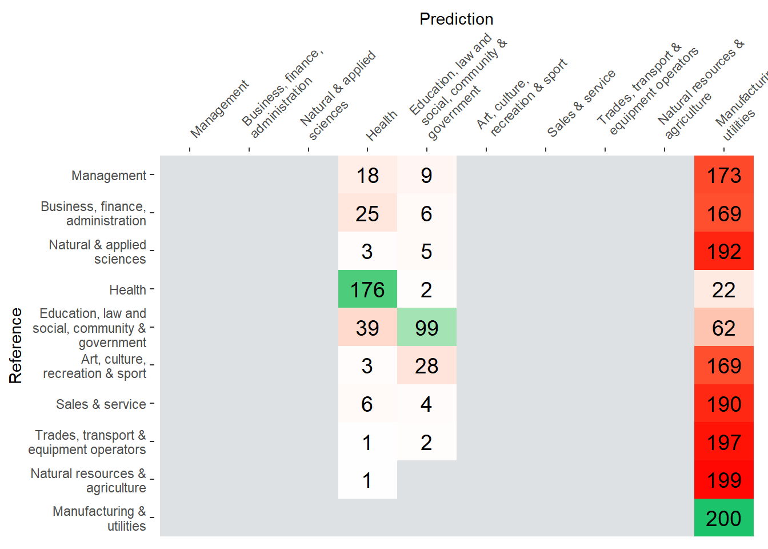
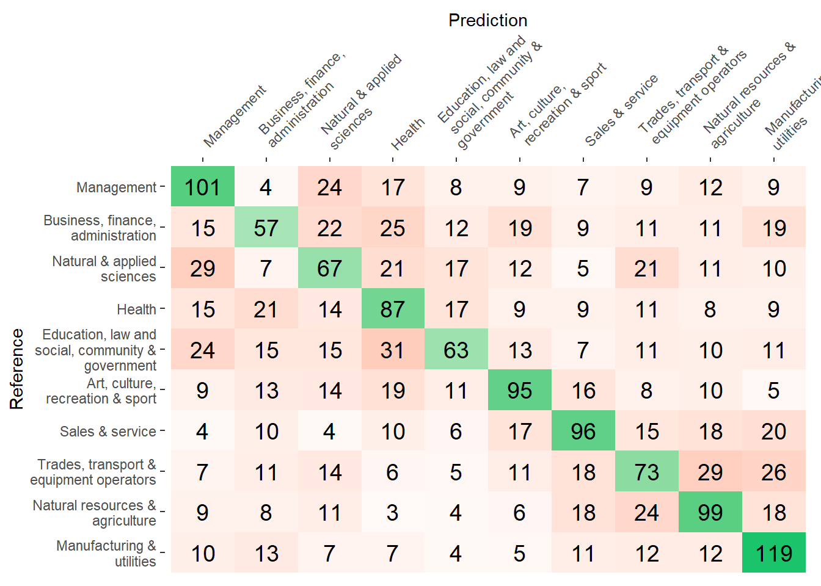
Model Performance Comparing Classification Algorithms
CART – Resample Method 2
KNN – Resample Method 2
Notes:
CART: not only is the accuracy low (25%), the model failed to predict 7 out of 10 classes.
KNN: lots of incorrect predictions. However the performance was better in predicting the Management class than the other ones.

Slide 28
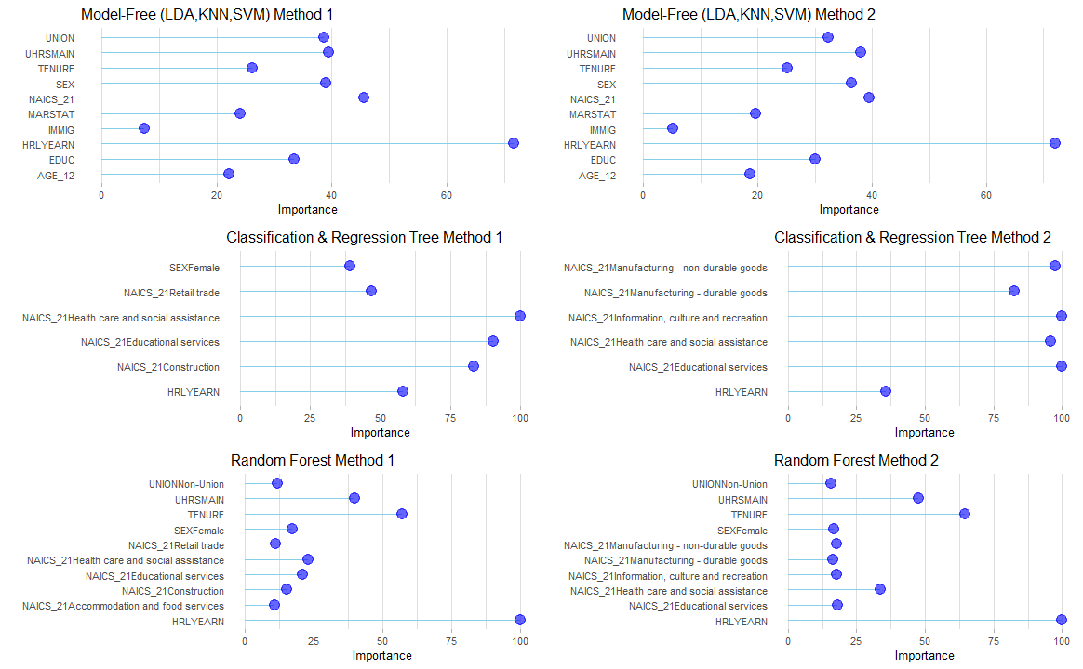
Variable Importance Model-based
Notes:
CART (only 6 variables are positively important, i.e. not 0) : Industries are the significant factors. Aligns with our expectation (many occupations are directly related to the industry of work), see barchart for details
RF (display only the top 10 most important variables): numerical predictors have more weight than categorical predictors.
Immigration status, marital status, education, age not significant
Model-based, as it sounds, has an agent trying to understand its environment and creating a model for it based on its interactions with this environment. In such a system, preferences take priority over the consequences of the actions i.e. the greedy agent will always try to perform an action that will get the maximum reward irrespective of what that action may cause.
https://neptune.ai/blog/model-based-and-model-free-reinforcement-learning-pytennis-case-study

Slide 29
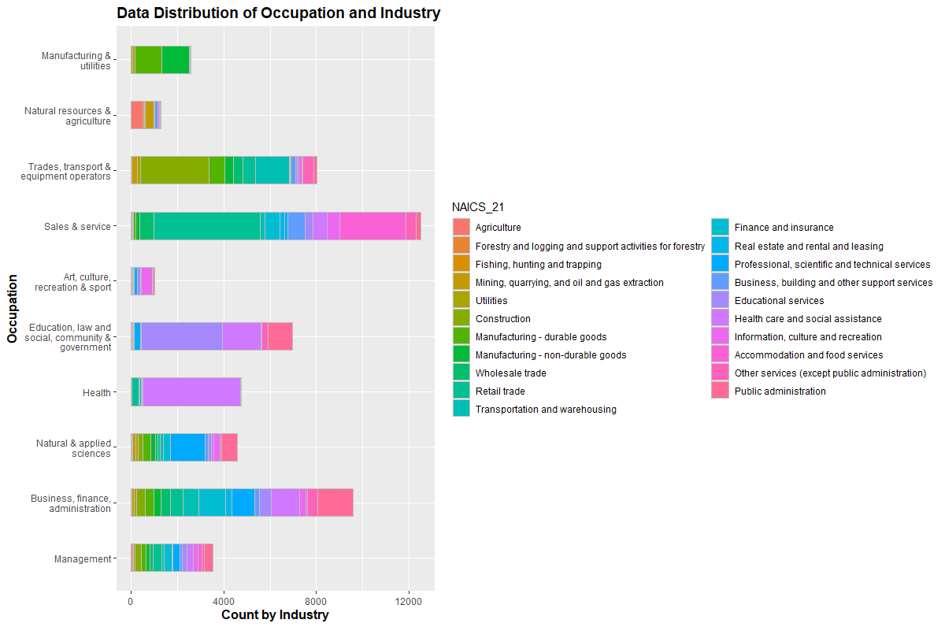
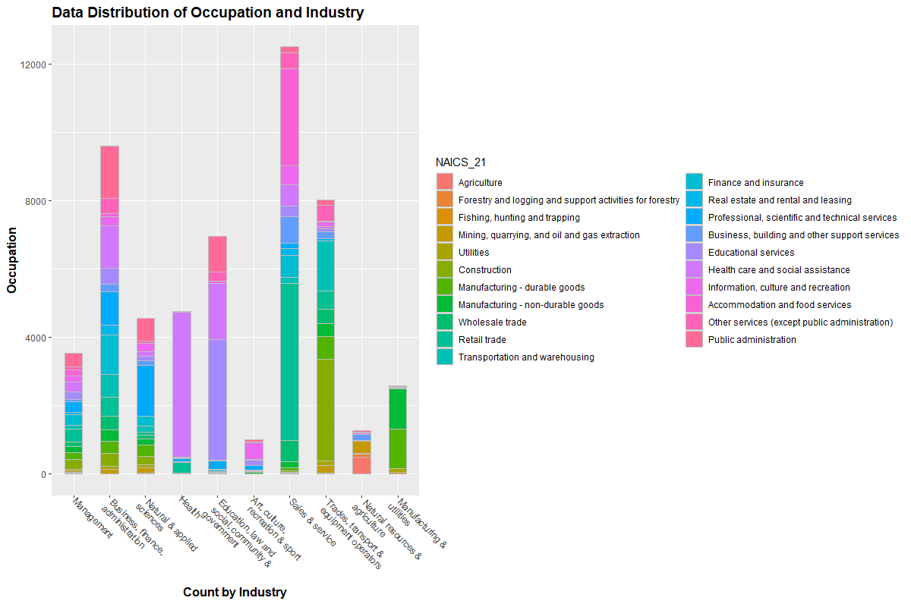
Notes:
Highlight: Health; Education; Art; Manufacturing; Trades

Slide 30
Variable Importance Model-Free
Notes:
Linear Discriminant Analysis, K-Nearest Neighbor, and Support Vector Machine are model-free algorithms and do not produce the same variable importance metrics as the Model-based algorithms such as RF and CART. We can still evaluate these model-free scores, and see that hourly earing weighs the most in terms of importance, and immigration status the least.
model-free algorithms seek to learn the consequences of their actions through experience via algorithms such as Policy Gradient, Q-Learning, etc. In other words, such an algorithm will carry out an action multiple times and will adjust the policy (the strategy behind its actions) for optimal rewards, based on the outcomes.
Model-based, as it sounds, has an agent trying to understand its environment and creating a model for it based on its interactions with this environment. In such a system, preferences take priority over the consequences of the actions i.e. the greedy agent will always try to perform an action that will get the maximum reward irrespective of what that action may cause.
https://neptune.ai/blog/model-based-and-model-free-reinforcement-learning-pytennis-case-study

Slide 31


Next Steps
Data modification
Details vs. Noise
Perfect Model?
Approach
Removed `Immigration Status` from the model
Ran the SVM model using method 2
Result?
Not at this stage
Original Mean Accuracy | Refined Mean Accuracy
0.597 | 0.596
Notes:
Our analysis aimed to predict occupation type (`NOC_10`) using the variables available in the LFS dataset. In order to do this effectively, we needed to carefully examine the relationships between `NOC_10` and the other variables, and determine which ones were most important for our predictive modeling. We also had to consider which variables provided useful information, and which ones might be considered "noise" that could affect the accuracy of our predictions.

Slide 32
Next Steps (cont’d)
Data modification
Details vs. Noise
Investigate relationships between target variable and predictors
Understanding of model algorithms
Notes:
As a result of our investigation, we have come to the view that it is not possible to confidently determine a personas occupation type based on our set predictors. This is likely due to the complex and varied nature of modern occupations, which cannot be accurately captured by a single algorithm or model. Our findings underline the need for additional study in this field to advance our knowledge of the variables influencing occupation type and enable more precise forecasts in the future.

Slide 33

Acknowledgement
We would to thank everyone in attendance today for being present and following along with us. We would also like to express our gratitude for Dr. Edwards for his support and encouragement. A thank-you also goes out to Statistics Canada for providing this lovely dataset, that fueled our exploration into the wonderful world of data science.

